Slide 1
UI designing for the automated face detection application for the university attendence.

Slide 2
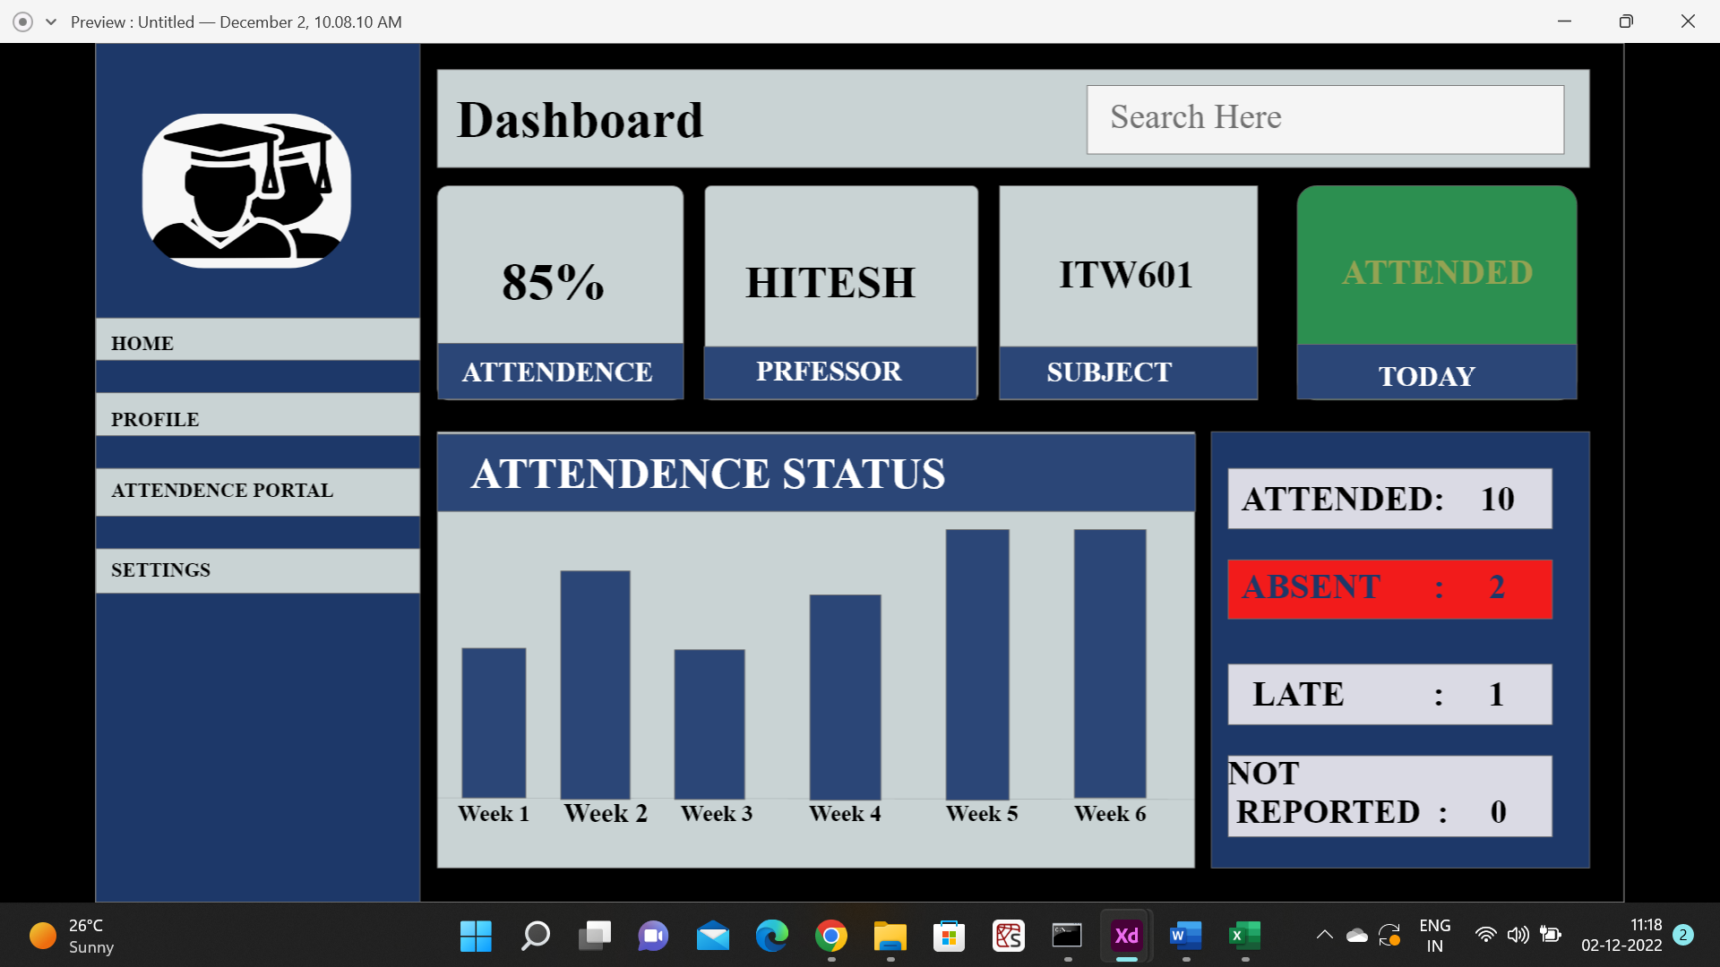

Slide 3
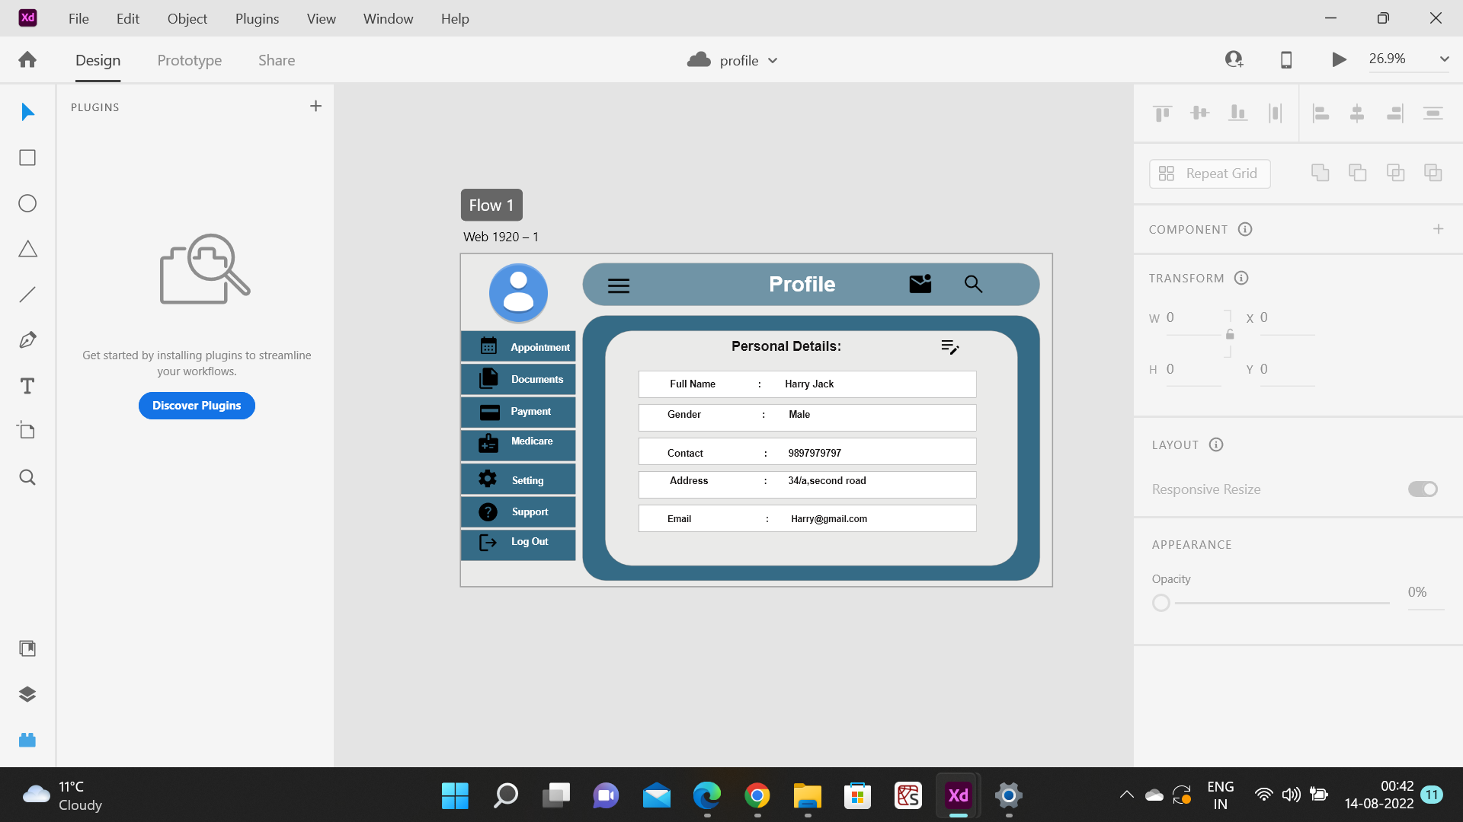

Slide 4
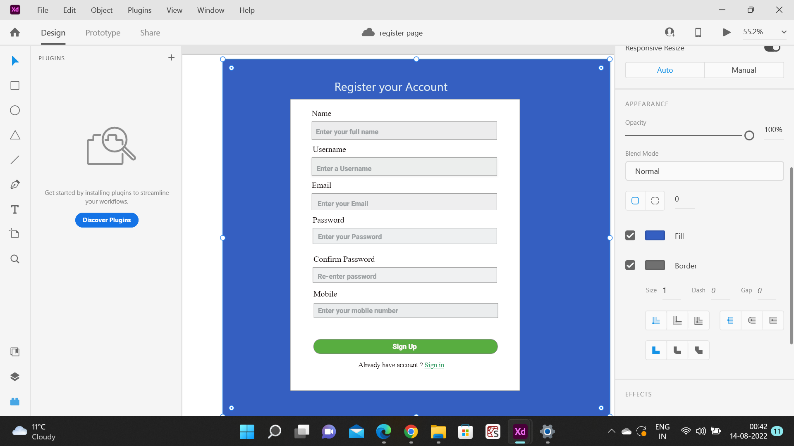

Slide 5
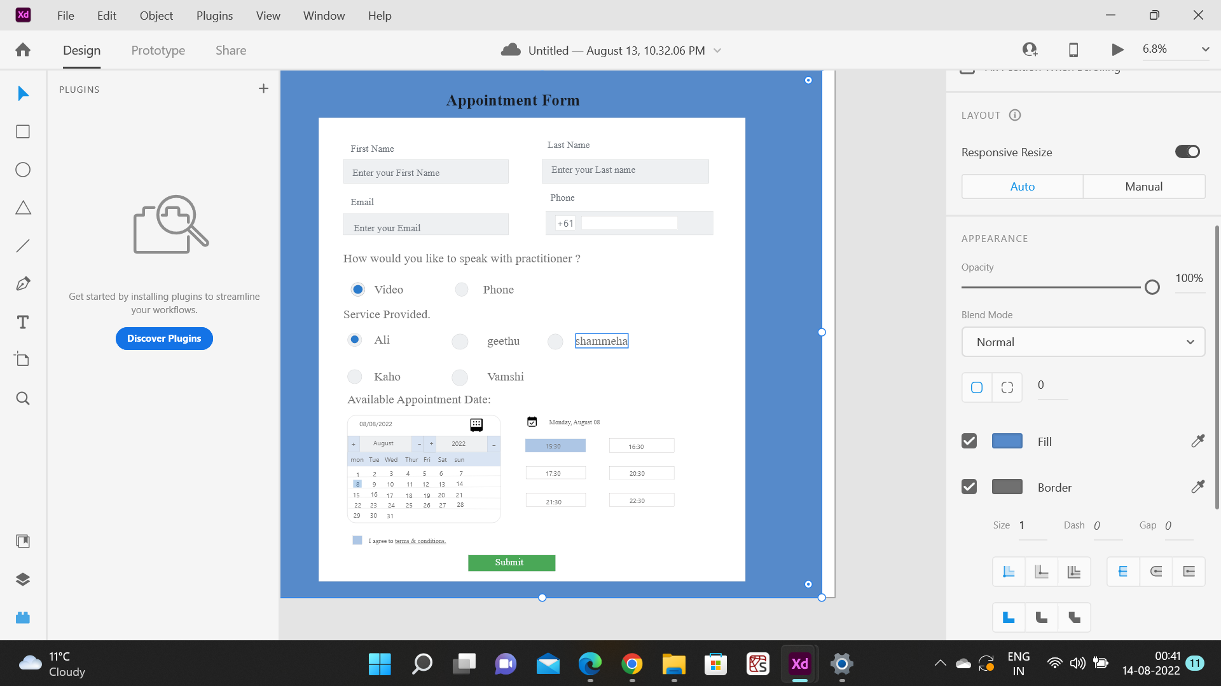

Slide 6


Slide 7
